Slide 1

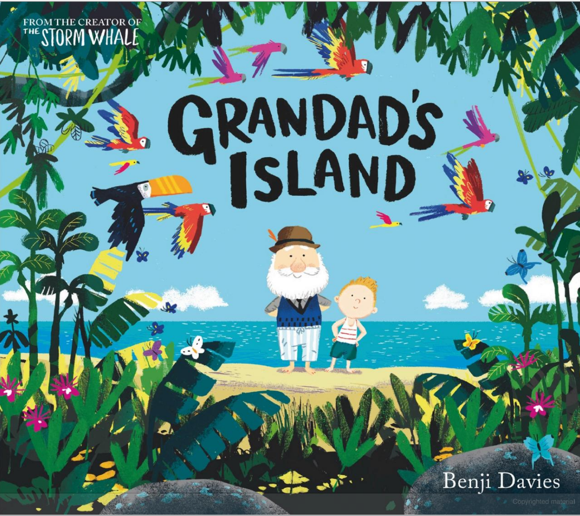
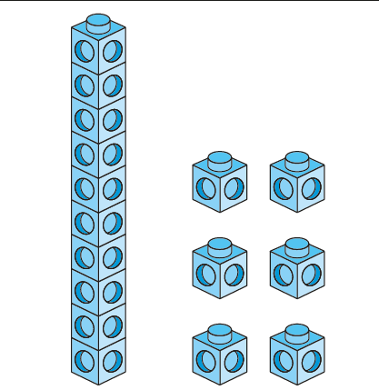
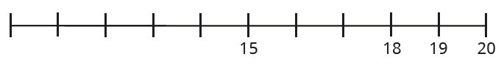
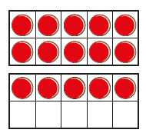
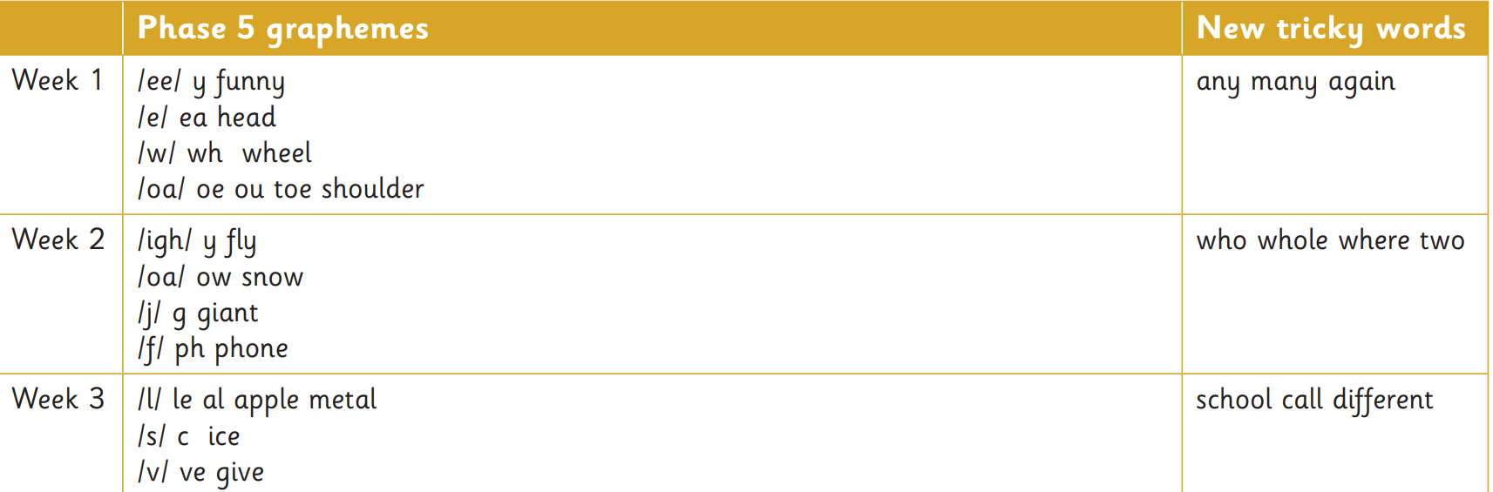
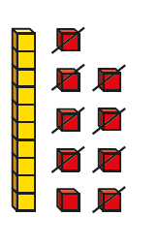
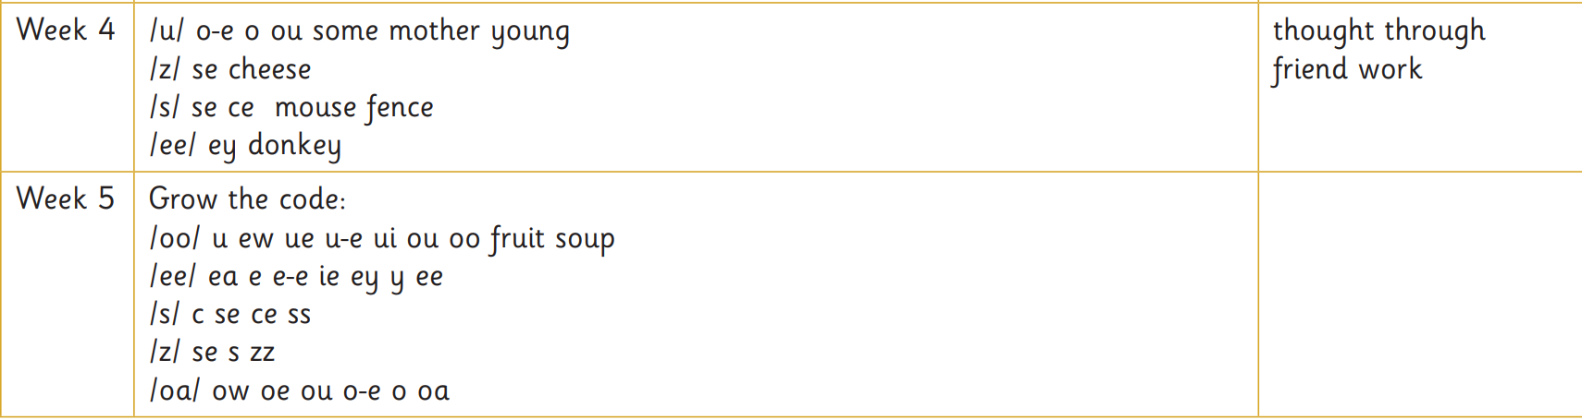
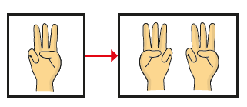
Year 1 Term 3
Whole School |  | Whole Child |  | Whole Hearted
Identity & Diversity | Curiosity |  | Life Skills |  | Environment
Our school value this term is: Independence
 | English
 | Writing | Reading
Key Texts |  | Little Wandle phase books. FRED’s Teaching texts.
Curriculum Objectives | Children will be able to accurately use: Capital letters, full stops, finger spaces, proper letter formation. s/es to make plurals without changing the root word. Capital letters for names of people, places and I. | Make inferences about a text based on what is being said and done, make predictions on a story based on what has been read so far and discuss the significance of the title and events.
Writing Outcomes | Fiction – Innovate a familiar story. Year 1 will rewrite the story of Grandad’s Island with alternative characters. Non- Fiction – Write to Inform. Year 1 will write a description of their own imagined Island. | Phonics
Maths
Place value (within 20) | In this unit we will be understanding that numbers over 10 are made up of a 10 and some 1s. We will count and compare numbers to 20 as well as estimating on a number line to 20.
Addition and subtraction (within 20) | We will use our knowledge of numbers within 20 to count on to add, look at doubles and near doubles to help us add. We will also count back and find the difference to work out subtraction questions.

Slide 2
Year 1 Term 3
Whole School |  | Whole Child |  | Whole Hearted
Identity & Diversity | Curiosity |  | Life Skills |  | Environment
Our school value this term is: Independence
Topic | Big Question | Learning
Science | How do we choose which materials to use? | By the end of the term, children will be able to: Compare the suitability of different materials for different purposes. Eg. Why do we use a waterproof material for raincoats? Describe materials using words like: hard, soft, strong, weak, heavy, smooth, rough etc. Know from observation what an object is made from and how they know. Eg. A cup is made from glass, I know this because it is transparent and can break easily
History | How have children’s toys changed since our grandparents were little? | By the end of the term, children will be able to: Explain and understand the term ‘living memory’. Compare old toys and new toys including the material they were made from and the technology inside them.
Art | Spirals | By the end of term, children will have: Created a spiral drawing using different mediums like graphite and pen. Drawn from observation for a few minutes at a time.
Music | Hey You! Glockenspiel | The children will learn about the differences between pulse, rhythm and pitch and to learn how to rap and enjoy it in its original form. As well as learning to sing, play, improvise and compose with this song, children will listen and appraise other Old-School Hip Hop tunes.
Personal, Social, Health Education (PSHE) | Dreams and goals | Children will learn how to set goals and make steps on how to achieve them as well as thinking about challenges we might face when trying to reach these goals.
Computing | Digital writing | Children will practice writing and resizing words on a word processor, using a mouse/trackpad and saving their work.
Physical Education | Ball skills: Hands | Children will be able to send and receive the ball with their hands, practicing accuracy in their aim and moving their body in line with the ball.
Religious Education | How and why do we celebrate special and sacred times? | Children will discuss why and how Christians celebrate Christmas and harvest times as well as how and why Muslims celebrate Eid.

