Slide 1

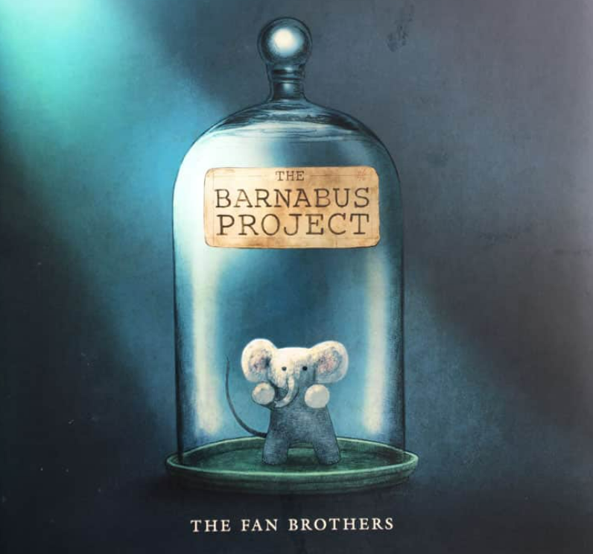


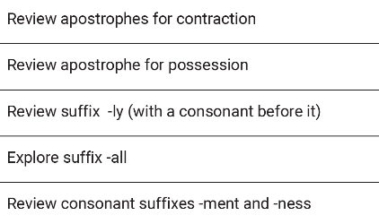
Year 3 Term 3
Whole School |  | Whole Child |  | Whole Hearted
Identity & Diversity | Curiosity |  | Life Skills |  | Environment
Our school value this term is: INDEPENDENCE
 | English
 | Writing | Reading
Key Texts
Curriculum Objectives | Start to use paragraphs to group related information Use simple organisational devices e.g. letter format Use the progressive form of the verb to show actions in Cohesive devices (pronouns/ prepositional phrases/ conjunctions) Character speech | Predict based on an unknown book and new chapters Use techniques to unpick new vocabulary Infer characters through using an extract of the text Use key information and main events to summarise chapters
Writing Outcomes | Narrative: Barnabus plans to rescue the pets Non-Fiction: Informal letter from the green suits to the police informing them a crime has taken place | Spelling
Maths
Multiplication and Division A & B | Recall and use multiplication and division facts for the 3, 4 and 8 multiplication tables Write and calculate mathematical statements for multiplication and division using the multiplication tables that they know, including for two-digit numbers times one-digit numbers, using mental and progressing to formal written methods Solve problems, including missing number problems, involving multiplication and division, including positive integer scaling problems and correspondence problems in which n objects are connected to m objects

Slide 2
Year 3 Term 3
Whole School |  | Whole Child |  | Whole Hearted
Identity & Diversity | Curiosity |  | Life Skills |  | Environment
Our school value this term is: INDEPENDENCE
Topic | Big Question | Learning
Science | Magnets and forces | Compare how things move on different surfaces. Know how a simple pulley works and use making lifting an object simpler Notice that some forces need contact between two objects, but magnetic forces can act at a distance. Observe how magnets attract and repel each other and attract some materials and not others. Compare and group together a variety of everyday materials based on whether they are attracted to a magnet and identify some magnetic materials. Describe magnets as having two poles. Predict whether two magnets with attract or repel each other, depending on which poles are facing.
RE | Jewish family life and festivals | What are some Jewish beliefs? What is Shabbat? What is Rosh Hashanah? What is Yom Kippur? What is Pesach?
Geography | How does chocolate impact local communities? | Explain that cocoa beans are produced in countries that have a tropical climate due to hotter weather and having both wet and dry seasons. Identify that Fairtrade as a scheme that allows farmers to receive a fair and set pay. Explain that Fairtrade support communities by ensuring they are treated fairly. Name one social, one economic and one environmental benefit of Fairtrade on communities.
French | La Date (The Date) | Repeat and recognise the months of the year in French. Ask when somebody has a birthday and say when they have their birthday. Say the date in French. Create a French calendar. Recognise key dates in the French calendar.
DT | Aprons / Willy Wonka’s Fairtrade cookies | Research about different products Market research Design cookies Bake cookies Evaluate project
Music | History of Music | Define country music Identify the origins of country music Listen to and discuss examples of country music Identify who Johnny Cash was and his significance in music history. Identify key musical features of country music. Listen to examples of country music and describe what they hear.
PSHE | Dreams and goals | I can analyse my learning strengths and use this to design clear steps to help me improve. I am confident to discuss my successes and difficulties with others. I can explain the different ways that help me learn and what I need to do to improve. I am confident and positive when I share my success with others. I can tell you something I did well in a learning challenge and something I want to get better at. I am happy to talk about what I did well and say why it makes me feel good
PE | Dance | Develop and apply an understanding of how to react to a stimulus and create a motifs. Pupils will work in small groups to create sequences that use a range of apparatus that flow.

